Slide 1
AI Spam Email Detector
End-to-End AI Solution • Cybersecurity • Individual Project

Slide 2
1. Introduction
Protecting inboxes with Machine Learning
This project builds an AI-powered system that automatically classifies emails as Spam or Not Spam, strengthening cybersecurity by filtering out phishing, scams, and malicious content before they reach the user.
98%
typical spam-filter accuracy with ML

Slide 3
2. Problem Statement
Email is the #1 attack vector
Billions of spam and phishing emails are sent every single day.
These messages steal passwords, spread malware, and trick users into scams.
Traditional rule-based filters cannot keep up with evolving attacks.
Manual filtering is slow, inconsistent, and impractical at scale.

Slide 4
3. Objectives
1
2
Detect spam automatically
Improve email security
3
4
Reduce phishing attacks
Showcase AI in cybersecurity

Slide 5
4. Technologies Used
Python
Scikit-learn
NLP
CountVectorizer
Naive Bayes
React + TS

Slide 6
5. AI Workflow
Email Input
▶
Text Processing
▶
AI Model
▶
Prediction
▶
Result
Each email flows through preprocessing, vectorization, and classification.

Slide 7
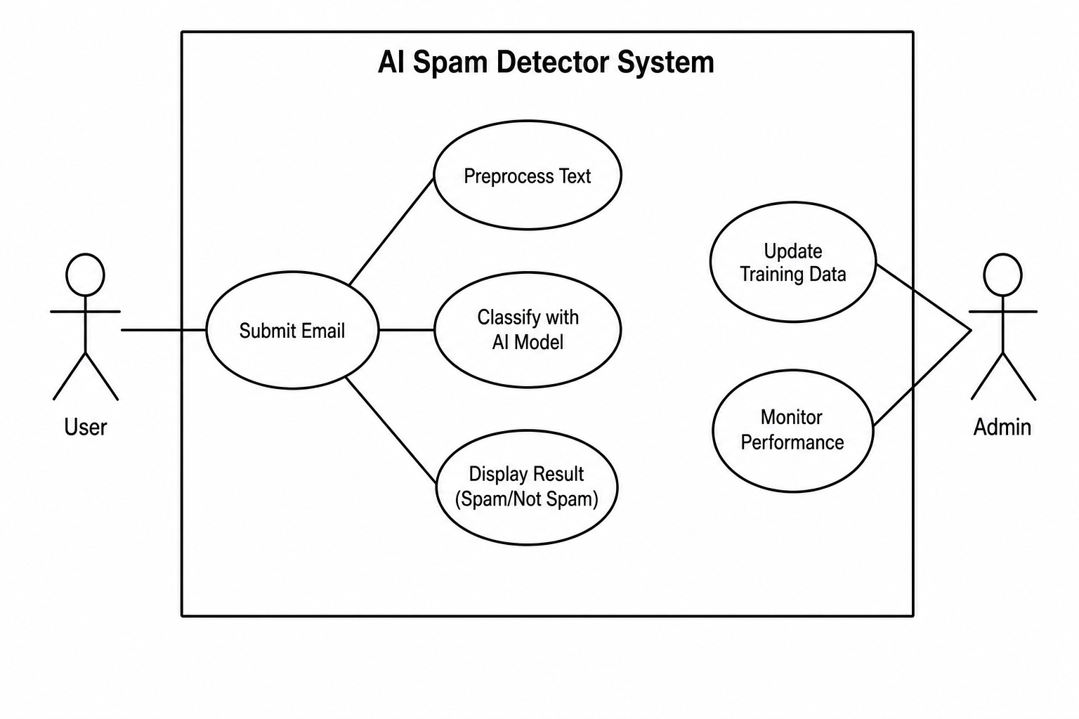
6. Use Case Diagram

Slide 8
7. Functional Prototype
spam_detector.py
from sklearn.feature_extraction.text import CountVectorizer
from sklearn.naive_bayes import MultinomialNB
emails = ["Win money now", "Free prize", "Meeting at 2pm",
"Lunch plans today", "Project update"]
labels = [1, 1, 0, 0, 0] # 1 = spam, 0 = not spam
vectorizer = CountVectorizer()
X = vectorizer.fit_transform(emails)
model = MultinomialNB()
model.fit(X, labels)
msg = input("Enter an email message: ")
pred = model.predict(vectorizer.transform([msg]))[0]
print("SPAM" if pred == 1 else "NOT SPAM")

Slide 9
8. Week 4 — Improvements
Add a graphical user interface (GUI) for everyday users.
Train on real datasets like Enron and SpamAssassin.
Improve accuracy with TF-IDF, n-grams, and ensemble models.
Detect phishing links via URL and domain reputation analysis.
Connect to real email services (Gmail / Outlook APIs).

Slide 10
9. Conclusion
AI makes inboxes safer.
Machine learning turns a flood of suspicious messages into a clean, trustworthy inbox — protecting users from phishing, scams, and malware.

